Slide 1
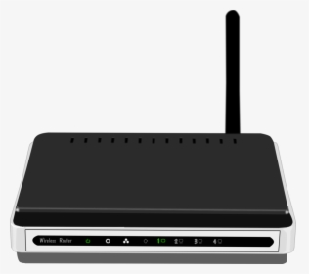
ROUTER
Router is a device which connects different networks- frequently over a large distances.
A router is a device that forwards data packets between computer networks, creating an overlay internetwork.

Slide 2
ROUTER
Is used in LAN and WAN Environments.
A router is connected to two or more data lines from different networks. When a data packet comes in on one of the lines, the router reads the address information in the packet to determine its ultimate destination.
A data packet is typically forwarded from one router to another through the networks that constitute the internetwork until it gets to its destination node.
It contains a routing table in which all information about the address of connected networks.

Slide 3
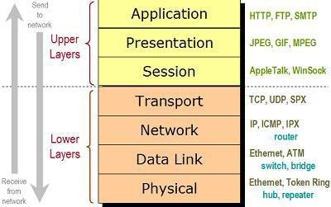
Router operates in network layer of OSI model

Slide 4
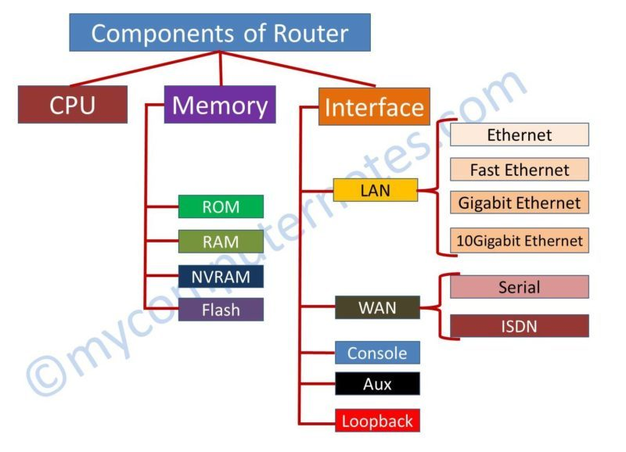
Router Internal Components

Slide 5
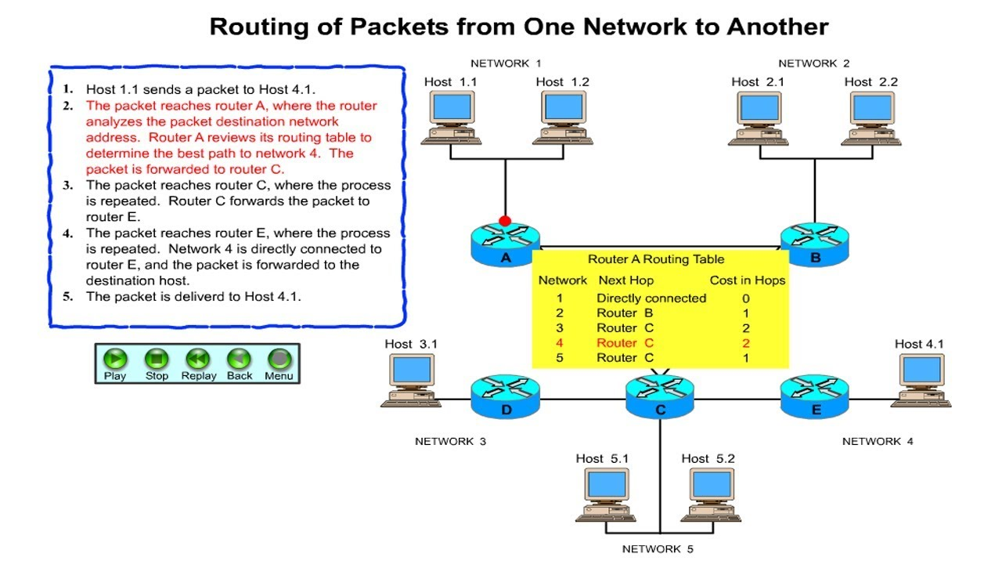

Slide 6
Types of Router
Wireless Router
They used to offer a wifi connectivity to laptop, smartphones and other devices.
Core Router
core router is used to connect different cities.
CISCO 12000 series is ex. of core router.

Slide 7
Advantages of Routers
Router limits the collision domain.
Router can function on LAN & WAN.
Routers can connects different media & architectures.
Security.

Slide 8
Disadvantages of Routers
Router is more expensive than Hub, Bridge & Switch.
Router only works with routable protocol.
Increase latency due to greater degree of packet filtering.

Slide 9
Bridge
A bridge in a computer network is one kind of network device, used to separate a network into sections.
Every section in the network represents a collision domain that has separate bandwidth. So that network performance can be improved using a bridge.
In the OSI model, a bridge works at layer-2 namely the data link layer. The main function of this is to examine the incoming traffic and examine whether to filter it or forward it.

Slide 10
Use of Bridge in Computer Network
A bridge in a computer network connects with other bridge networks that utilize a similar protocol.
These network devices work at the data link layer in an OSI model to connect two different networks and provide communication between them.
Similar to hubs and repeaters, bridges broadcast data to each node. But, maintains the MAC (media access control) address table to find out new segments. So following transmissions are transmitted to the preferred receiver only.
A bridge utilizes a database to determine where to transmit otherwise remove the data frame.

Slide 11
Types of Bridge
Transparent Bridge
Translational Bridge
Source-route Bridge

Slide 12
Functions of Bridges in Network
This networking device is used for dividing local area networks into several segments.
In the OSI model, it works under the data link layer.
It is used to store the address of MAC in PC used in a network and also used for diminishing the network traffic.

Slide 13
Advantages of Bridges
It acts as a repeater to extend a network
Network traffic on a segment can be reduced by subdividing it into network communications
Collisions can be reduced.
Some types of bridges connect the networks with the help of architectures & types of media.
Bridges increase the available bandwidth to individual nodes because fewer network nodes share a collision domain
It avoids waste BW (bandwidth)
The length of the network can be increased.
Connects different segments of network transmission

Slide 14
Disadvantages of Bridges
It is unable to read specific IP addresses because they are more troubled with the MAC addresses.
They cannot help while building the network between the different architectures of networks.
It transfers all kinds of broadcast messages, so they are incapable to stop the scope of messages.
These are expensive as we compare with repeaters
It doesn’t handle more variable & complex data load which occurs from WAN.

Slide 15
Internet Service Provider (ISP)
An Internet service provider (ISP) is an organization that provides services for accessing, using, or participating in the Internet.
Internet services typically provided by ISPs can include Internet access, Internet transit, domain name registration, web hosting, Usenet service, and colocation.
An ISP typically serves as the access point or the gateway that provides a user access to everything available on the Internet. Such a network can also be called as an eyeball network.

Slide 16
Thanks for listening me …….

